Slide 1
Printing Management System
SWE363-Web Development

Slide 2

TABLE OF CONTENTS
01
04
02
05
03
About Us
Functionalities
Executive Summary
Storyboard
Users of the application

Slide 3

Meet Our Project Team
Ayman Musalli
Mohammed Sohail
Moaz Ahmed
Ahmed Alnasser
UI/UX Designer
Back-End Developer
Frond-End Developer
Full-Stack Developer
Designs intuitive user interfaces, creates wireframes and prototypes, and focuses on usability, accessibility, and smooth user experiences.
Builds FastAPI backends, designed REST APIs, integrated databases, optimized retrieval pipelines, ensuring sub-second responses, deployments
Builds responsive user interfaces, implements interactive components, and ensures smooth user experiences across devices.
Develops and integrates application features, works across multiple system layers, and supports reliable and scalable solutions.

Slide 4
Executive Summary
The College of Computing and Mathematics currently relies on a paid third-party printing solution that supports basic printing operations but offers limited flexibility, restricted visibility into usage, and continuous licensing costs. To address these limitations, this project proposes the development of a centralized, web-based Printing Management System tailored to the college’s academic environment. The system is designed to regulate and secure printing activities by supporting multiple user roles, including regular users (students, faculty, and staff), half administrators, and full administrators. Regular users will be able to submit print jobs, view their printing history, and manage their usage through a role-based printing quota system, where students are assigned lower quotas and restricted printer access, while faculty and staff are allocated higher printing allowances. When users exhaust their allocated quotas, they may submit requests for additional printing allowance, which can be reviewed and approved or rejected by administrative users. Half administrators will have limited oversight responsibilities such as handling quota requests and viewing reports, while full administrators will manage printers, enforce printing policies, and monitor usage across departments. Overall, the proposed system aims to improve transparency, accountability, and cost control while enhancing operational efficiency and better aligning printing services with the college’s needs.

Slide 5
Users of the application
Full Administrator
Regular User
Responsible for managing the overall printing management system, including user accounts, printers, printing policies, quota configurations, and system-wide monitoring across all departments. Full administrators oversee system settings and reporting to ensure proper operation and policy enforcement.
Authorized users who submit print requests through the system, authenticate at printers using their university ID, view their queued print jobs, and select documents to print. Users can also track their personal printing history within the system.
Half Administrator
Responsible for operational monitoring of the printing system, including checking printer availability and readiness (such as paper status and machine operation), monitoring printing activity, and reviewing usage reports. Half administrators support daily printing operations without full system control.

Slide 6

Functionalities: Full Administrator
Create, edit, and deactivate user accounts
Assign user roles and access permissions
Register and manage printers across departments
Configure printing policies and usage limits
Monitor printing activity and system usage
Review printing logs and usage history
Identify unusual or excessive printing behavior
Generate and export administrative reports

Slide 7

Functionalities: Half Administrator
Monitor printer availability and operational status (e.g., paper and readiness)
View current print queues and ongoing printing activity
Track printing usage through system reports
Review printing logs and usage history
Identify printers with frequent errors or high usage
Support daily printing operations across departments
Assist in monitoring system performance without full administrative control
Notified when printer needs maintenance/restocking

Slide 8

Functionalities: Regular User
access printers assigned to their department
Submit print jobs to selected printers
Authenticate before printing using their university ID
View the status of submitted print jobs
Cancel a print job before it is printed
View personal printing history and usage details
Receive notifications for failed jobs or quota limits
Request additional printing quota when needed

Slide 9
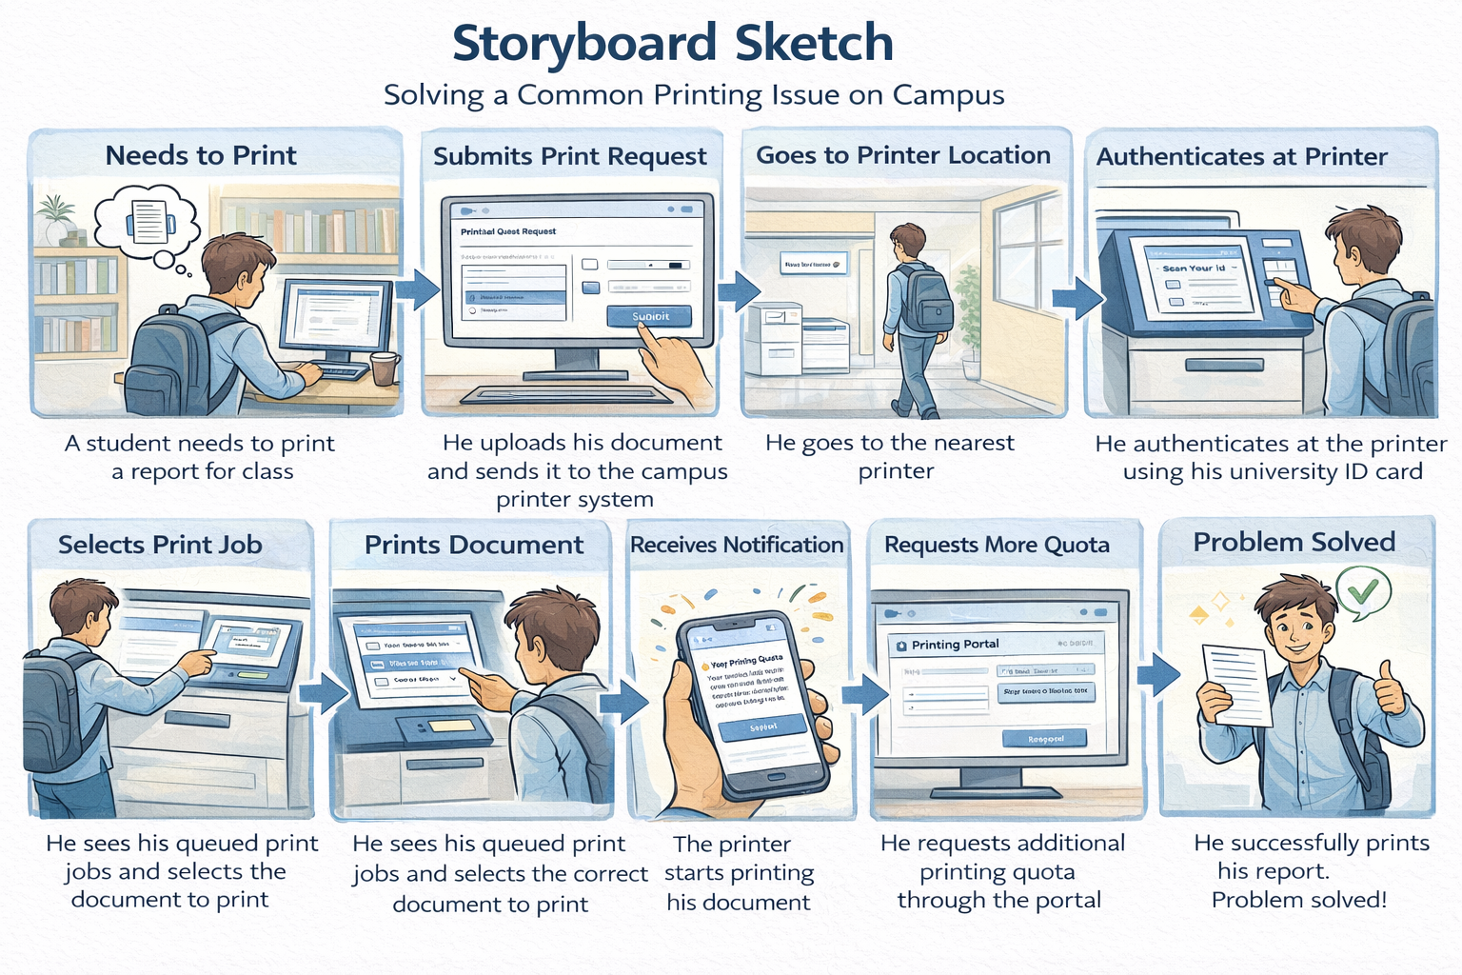

Slide 10


Thanks!

